Slide 1
CENG 477 Introduction to Computer Graphics
Data Structures for Graphics

Slide 2
Until Now
We rendered virtual objects
Ray tracing
Ray are easy: r(t) = o + dt
Mathematical objects also easy
(p – a).n = 0
(p – c).(p – c) – R² = 0
How about arbitrary objects embedded in 2D/3D scenes?
Today we will learn about
Explicitly representing those objects
Triangle meshes
Organizing them for efficiency
Spatial structures

Slide 3
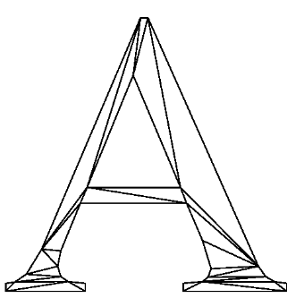
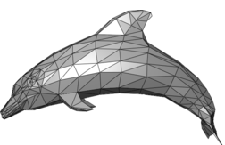
Triangle Meshes
The most popular way of representing geometry embedded in 2D or 3D
A triangle mesh is a piecewise linear surface representation
2D mesh
3D mesh

Slide 4
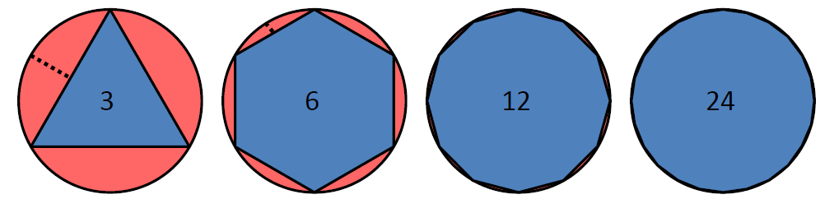
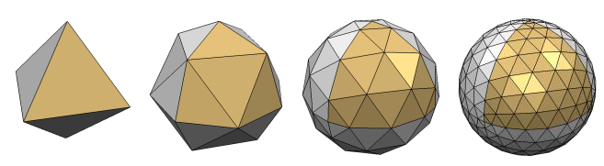
Triangle Meshes
Smoothness may be achieved by using a larger number of smaller pieces

Slide 5
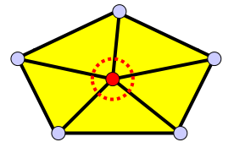
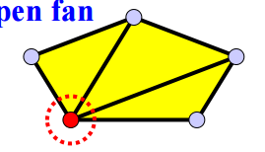
Manifolds
Most well-defined triangle meshes are manifolds:
Each edge is shared by at most two faces
And faces containing a vertex form a closed or open fan:
Closed fan
https://www.cs.mtu.edu/~shene
Open fan

Slide 6
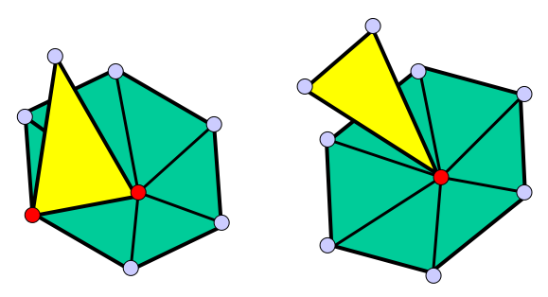
Non-manifolds
The following meshes are non-manifolds:
Such geometry is usually represented by multiple meshes
https://www.cs.mtu.edu/~shene

Slide 7
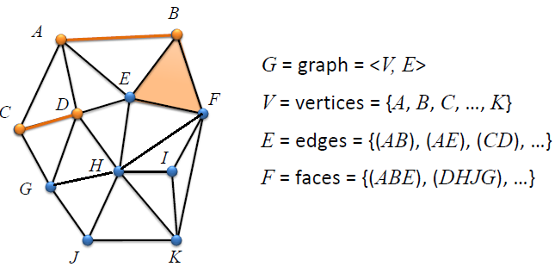
Triangle Meshes
Formally, a triangle mesh is an undirected graph with triangle faces
It has vertices, edges, and faces
The degree or valance of a vertex is the # of incident edges
A mesh is called k-regular if the degree of all vertices are k
G = <V, E, F>
V = {A, B, C, …, K}
E = {(A, B), (A, E), …}
F = {(A, E, B), (B, E, F), …}
deg(A) = 4
deg(E) = 5

Slide 8
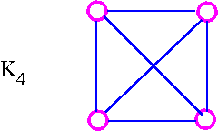
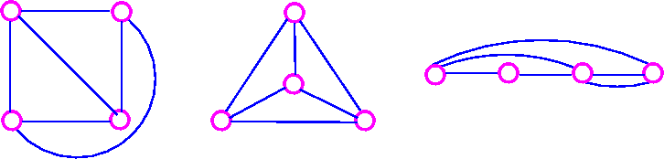
Graph Planarity
A graph is planar if it can be drawn in the plane such that no two edges cross each other (except at the vertices):
Planarize:
http://www.personal.kent.edu/~rmuhamma

Slide 9
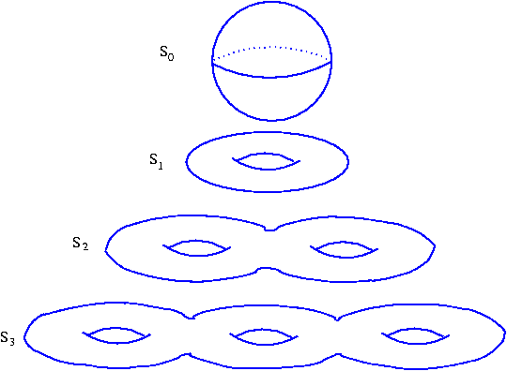
Mesh Statistics
Almost every mesh is a planar graph:
Formally, surfaces that do not have holes are planar graphs
Such surfaces are called genus-0
Genus number indicates the number of holes in the surfaces
Planar
Non-planar

Slide 10
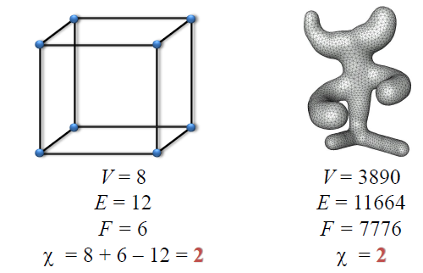
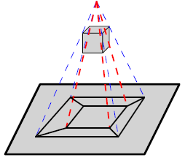
Mesh Statistics
For planar graphs Euler formula holds:
Proof is at the back of the slides
Trivia: does the formula hold for a single triangle (again see the back)
#V – #E + #F = 2

Slide 11
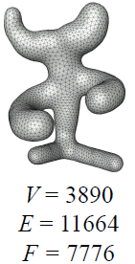
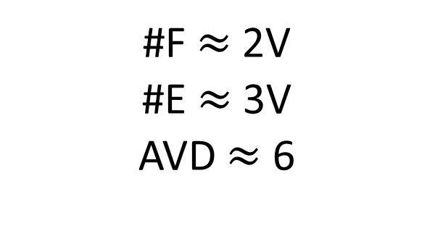
Mesh Statistics
Based on Euler’s formula:
See the back for the proof as well
#F $≈$ 2V
#E $≈$ 3V
AVD $≈$ 6
Average
vertex degree

Slide 12

Obtaining Meshes
How do we obtain meshes in the first place?
Explicitly construct them by defining vertices, edges, and faces
Can be done manually
Or modeling software (e.g. Blender) can be used
Use 3D scanner data to obtain point clouds
Directly triangulate the points (explicit)
Fit a surface and apply the marching cubes algorithm to determine the triangles (implicit)
Prof. Marc Levoy
https://engineering.stanford.edu/news/tale-ubiquitous-stanford-bunny

Slide 13
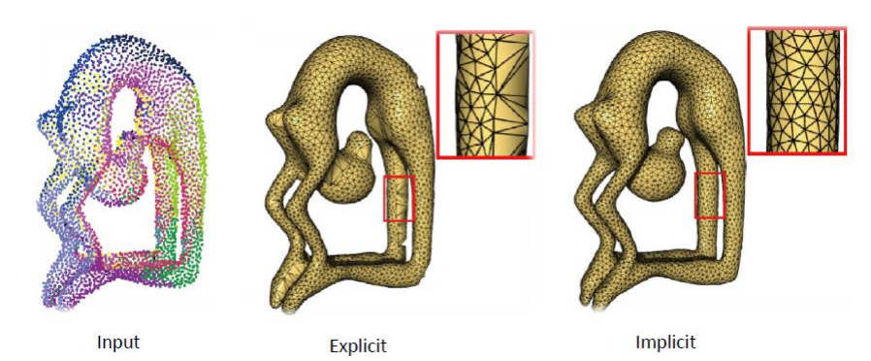
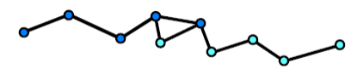
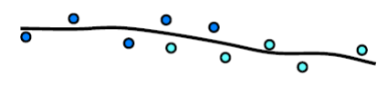
Explicit Reconstruction
Connect sample points by triangles
Exact interpolation of sample points
Bad for noisy or misaligned data (common in scans)
May lead to holes or non-manifoldness

Slide 14
Implicit Reconstruction
Create a voxel grid with the desired resolution
Estimate signed distance function (SDF) for each grid point
This produces a 3D scalar field
Extract the isosurface from this scalar field (Marching Cubes)
Approximation of input points (better in noisy situations)
Manifoldness by construction

Slide 15
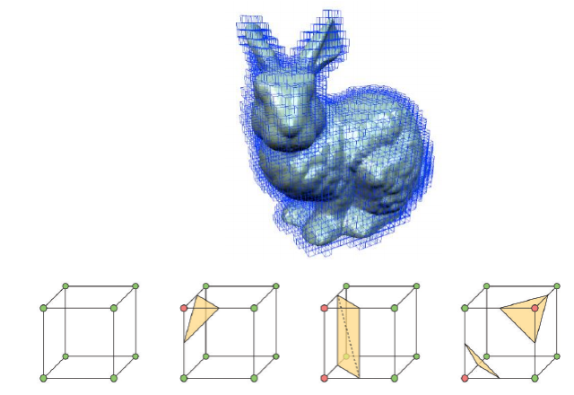
Marching Cubes
A continuous scalar field F is discretized in some bounding box around the object using a dense grid with nodes g

Slide 16
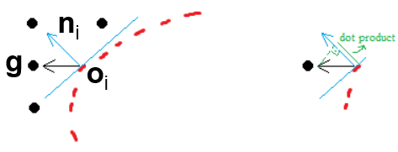
Marching Cubes
F is computed as a Signed Distance Function (SDF)
F(g) = (g-o_{i}).n_{i}
Nearest 3D point (scan output) to the current grid position g
n_{i} is the normal of that point (scan output or computed)

Slide 17
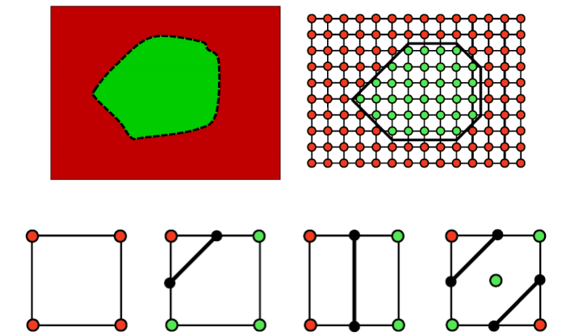
Marching Cubes
F(g) = (g-o_{i}).n_{i} // Positive F(g) in red, negative in green
Extract surface (or curve in this 2D case) where F = 0
Some of the possible configurations (2⁴ in 2D and 2⁸ in 3D)
g₀
g₁
Exact location determined by linearly interpolating between g₀ and g₁ using F(g₀) and F(g₁)

Slide 18
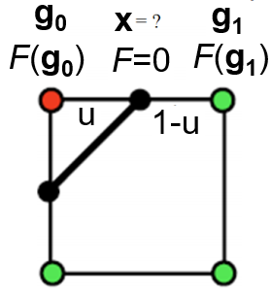
Marching Cubes
Given a red/green configuration, find the intersection point to locate the surface triangle’s vertex position x
F = F(g₀)*(1-u) + F(g₁)*u ➔ for F=0, u = F(g₀)/(F(g₀) - F(g₁))
x = (1 – u)g₀ + u*g₁
Lorensen, W. E., & Cline, H. E. (1998). Marching cubes: A high resolution 3D surface construction algorithm. In Seminal graphics: pioneering efforts that shaped the field (pp. 347-353).

Slide 19
Mesh Structures
How to store geometry & connectivity of a mesh
3D vertex coordinates Vertex adjacency
Attributes are also stored: normals, colors, texture coordinates, labels, …
Efficient algorithms on meshes to get:
All vertices/edges of a face
All incident vertices/edges/faces of a vertex

Slide 20
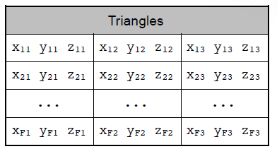
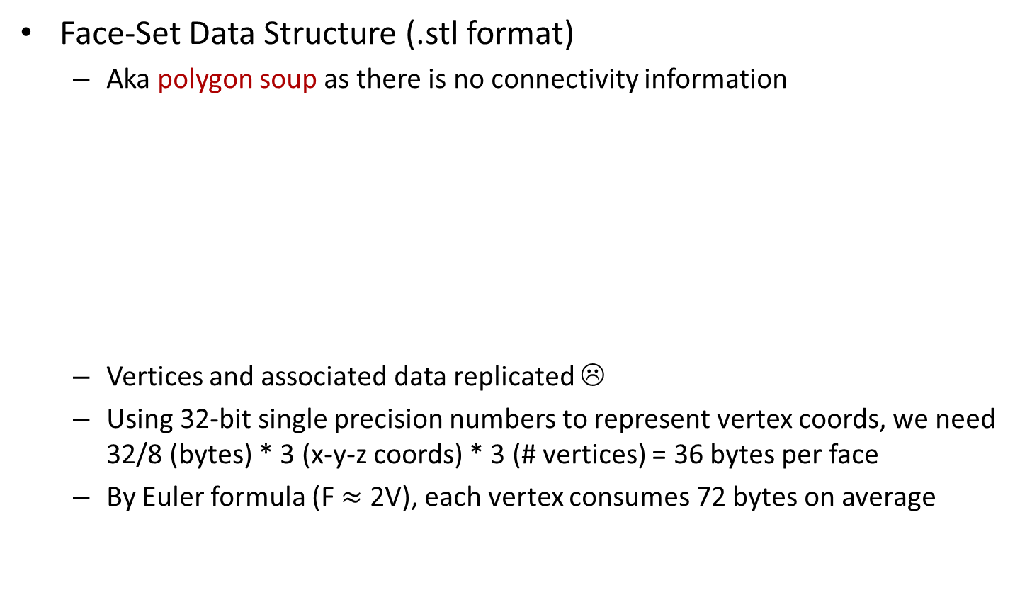
Face-based Structures
Face-Set Data Structure (.stl format)
Aka polygon soup as there is no connectivity information
Vertices and associated data replicated ☹
Using 32-bit single precision numbers to represent vertex coords, we need 32/8 (bytes) * 3 (x-y-z coords) * 3 (# vertices) = 36 bytes per face
By Euler formula (F $≈$ 2V), each vertex consumes 72 bytes on average

Slide 21
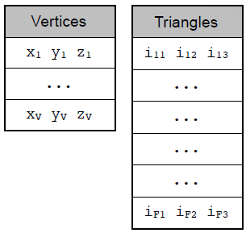
Face-based Structures
Indexed Face-Set Data Structure (.obj, .off, .ply, our XML format)
Aka shared-vertex data structure
No vertex replication ☺
We need 4 (bytes) * 3 (# indices) = 12 bytes per face (24 bytes per vertex)
We also need 4 (bytes) * 3 (x-y-z coords) = 12 bytes per vertex
Total = 36 bytes per vertex, half of Face-Set structure ☺
Furthermore, connectivity information is available which can be used for various purposes (e.g. smooth shading)

Slide 22
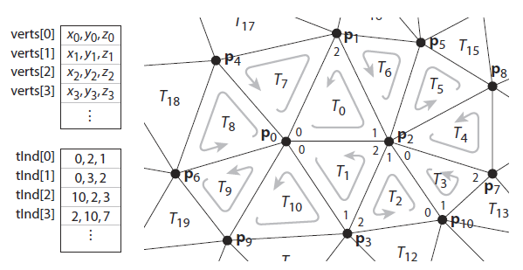
Face-based Structures
Regardless of the structure, triangle vertices must be stored in a consistent order
Mostly counterclockwise (CCW)

Slide 23
Data Structures for Graphics
With large number of triangles, rendering tasks tend to take too long if data is not properly organized
Many data structures exist
Quadtree
Octree
BSP tree
k-D tree
BVH

Slide 24
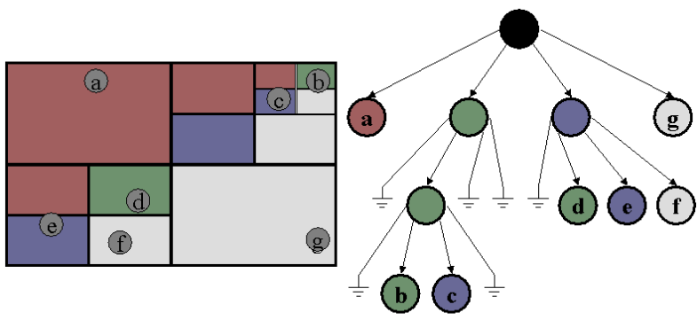
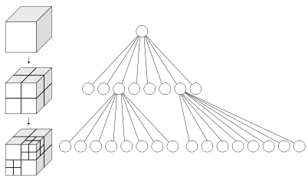
Quadtree and Octree
Quadtrees are used in 2D and octrees in 3D
Quadtree
Octree

Slide 25
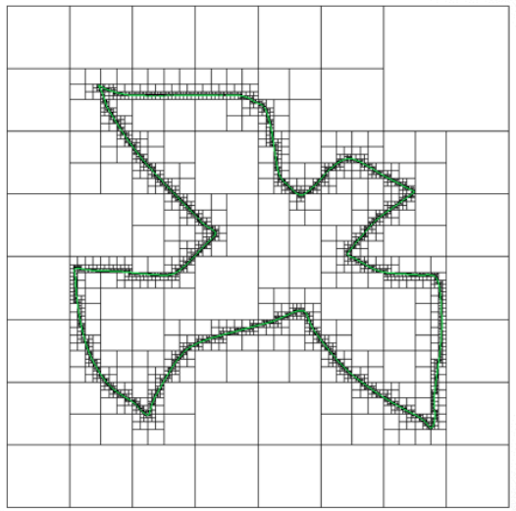
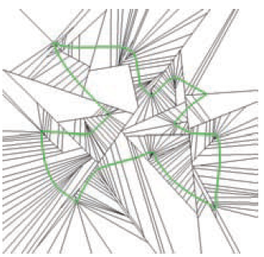
Binary Space Partitioning (BSP)
Divide the space with freely oriented lines (2D) and planes (3D)
Quadtree BSP tree
Quadtree
BSP
Notes:
In geometry a hyperplane is a subspace of one dimension less than its ambient space. If a space is 3-dimensional then its hyperplanes are the 2-dimensional planes, while if the space is 2-dimensional, its hyperplanes are the 1-dimensional lines.

Slide 26
Binary Space Partitioning (BSP)
BSP trees are view-independent (no need to reconstruct if the viewer moves)
BSP trees can be used to draw a scene in back-to-front order with respect to the viewer
Corresponding BSP tree

Slide 27
Binary Space Partitioning (BSP)
Assume camera is at point C
Always traverse the half-space first that does not contain C
This guarantees back-to-front traversal w.r.t. the camera
2
1
3
C
4
5
Corresponding BSP tree

Slide 28
Binary Space Partitioning (BSP)
BSP trees do not need to be recreated if the camera moves
Their traversal depends on the camera position
How to create a BSP tree?
Step 1: Select a polygon and create a plane aligned with it
Put that polygon to your root
Step 2: Separate the other polygons into two sets
One above the plane and other below the plane
If the plane intersects some polygons, split them and place them to their corresponding sets
Step 3: Recursively apply Step 1 and 2 until you reach a desired stopping condition
Notes:
In geometry a hyperplane is a subspace of one dimension less than its ambient space. If a space is 3-dimensional then its hyperplanes are the 2-dimensional planes, while if the space is 2-dimensional, its hyperplanes are the 1-dimensional lines.

Slide 29
Binary Space Partitioning (BSP)
Sample Input
Step 1
Step 2
Step 3
See: https://en.wikipedia.org/wiki/Binary_space_partitioning
Notes:
In geometry a hyperplane is a subspace of one dimension less than its ambient space. If a space is 3-dimensional then its hyperplanes are the 2-dimensional planes, while if the space is 2-dimensional, its hyperplanes are the 1-dimensional lines.

Slide 30
Binary Space Partitioning (BSP)
Step 4
Step 5
Step 6
Step 7
See: https://en.wikipedia.org/wiki/Binary_space_partitioning
Notes:
In geometry a hyperplane is a subspace of one dimension less than its ambient space. If a space is 3-dimensional then its hyperplanes are the 2-dimensional planes, while if the space is 2-dimensional, its hyperplanes are the 1-dimensional lines.

Slide 31
Binary Space Partitioning (BSP)
Step 9
See: https://en.wikipedia.org/wiki/Binary_space_partitioning
Notes:
In geometry a hyperplane is a subspace of one dimension less than its ambient space. If a space is 3-dimensional then its hyperplanes are the 2-dimensional planes, while if the space is 2-dimensional, its hyperplanes are the 1-dimensional lines.

Slide 32
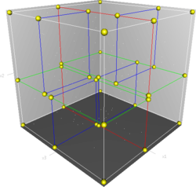
k-D Tree
In a k-D tree, a scene is recursively divided into 2 convex sets by axis-aligned hyperplanes: a special case of BSP tree
wikipedia.com

Slide 33
k-D Tree
k-D tree is a binary tree
Each node is a k-dimensional point
Splitting planes can be alternatingly chosen between dimensions:
First x, then y, then z, back to x and so on (axis = (axis + 1) % 3)
It will be a balanced tree if the median element is chosen at each split
Log₂(n) depth in that case

Slide 34
k-D Tree
To construct a k-D tree we first compute the overall bounding box of the scene
Bounding box
ray

Slide 35
k-D Tree
Then a splitting axis and position along this axis must be chosen
Surface area heuristic
Median heuristic
Midpoint heuristic
Split such that surface areas are equal
Split from the median element
Split from the midpoint of the region
Bounding box
ray

Slide 36
k-D Tree
Some primitives may belong to both regions
Similar to the grid
The green triangle belongs to both left and right halves
Bounding box
ray

Slide 37
k-D Tree
We keep dividing recursively until:
We reach a maximum predefined level or
There is zero, one, or a predefined number of primitives in a given region
Bounding box
ray

Slide 38
k-D Tree
Note that the k-D tree divides the space into disjoint regions
But, one object may be assigned to multiple regions
Each node stores:
Splitting axis (x, y, or z)
Position along the splitting axis
Pointers to left and right k-D trees

Slide 39
k-D Tree
Both the construction and traversal of the k-D tree is recursive
For traversal:
Start at the root node
If a ray intersects its bounding box
First check the region that the ray enters
If there is an intersection within the bounds of that region, stop
Otherwise check the other region

Slide 40
k-D Tree
If there is an intersection but it is not within the bounds of that region, we need to continue
There could be a closer object in the other region
Same issue as in the grid structure

Slide 41
Bounding Volume Hierarchy (BVH)
While k-D trees partition space into disjoint regions, a BVH partitions objects into disjoint polygons
k-D tree: space subdivision
BVH: object subdivision
Objects are contained within bounding boxes (aka bounding volumes)

Slide 42
Bounding Volume Hierarchy (BVH)
Rays missing the bounding boxes are not intersected with the actual objects
Bounding box
ray

Slide 43
Bounding Volume Hierarchy (BVH)
Bounding boxes can be made hierarchical
Overlap between bounding boxes are possible (whereas in a k-D tree overlap between regions is not possible)
ray

Slide 44
Bounding Volume Hierarchy (BVH)
Bounding boxes can be made hierarchical
Overlap between bounding boxes are possible
ray

Slide 45
Bounding Volume Hierarchy (BVH)
BBs may go all the way down to individual primitives (triangles)
ray

Slide 46
Bounding Volume Hierarchy (BVH)
This is represented as a binary tree where only the leaf BBs contain the actual objects

Slide 47
Bounding Volume Hierarchy (BVH)
A ray missing this box
cannot intersect any
objects it bounds

Slide 48
Bounding Volume Hierarchy (BVH)
A ray missing this box
cannot intersect any
objects it bounds

Slide 49
Bounding Volume Hierarchy (BVH)
Note that a ray may intersect with multiple bounding boxes
ray

Slide 50
Bounding Volume Hierarchy (BVH)
Intersecting boxes are shown in bold
Note that this ray does not intersect with any real object

Slide 51
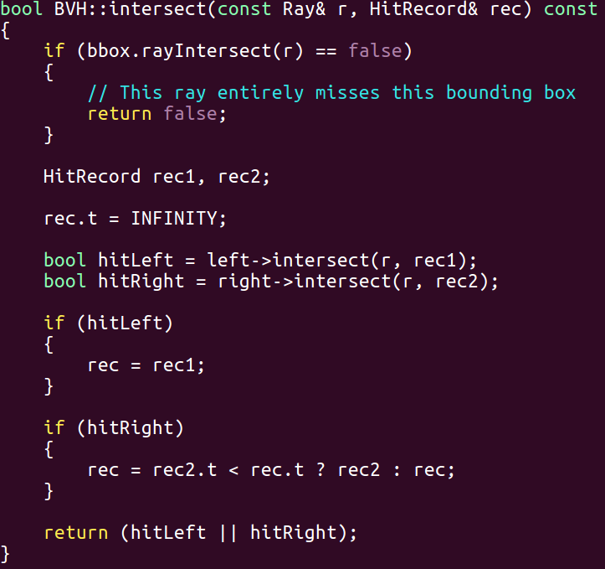
Bounding Volume Hierarchy (BVH)
Basic traversal algorithm:

Slide 52
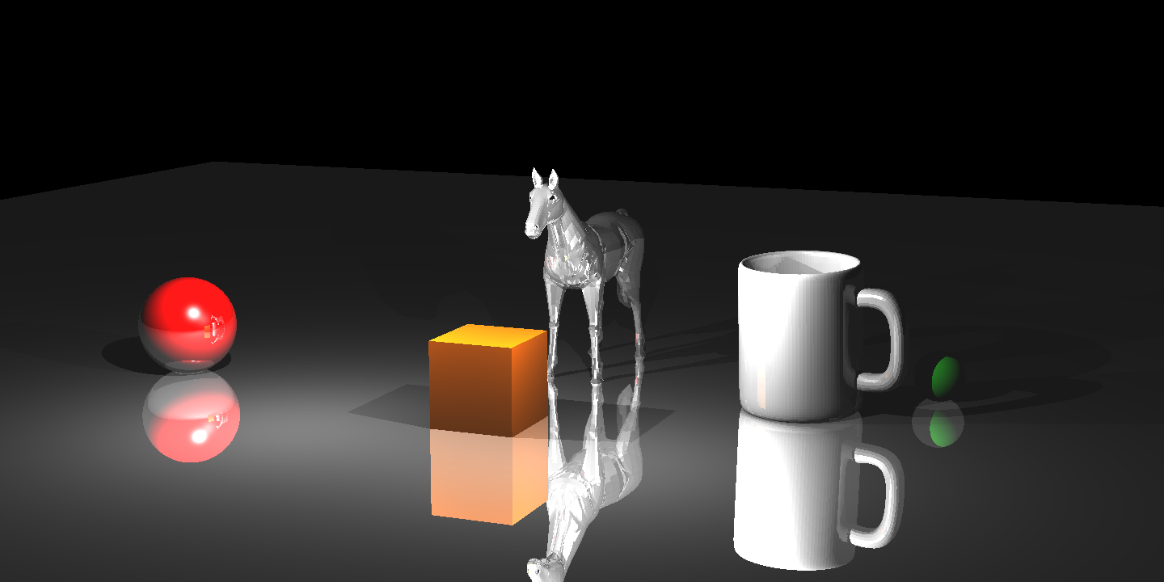
Bounding Volume Hierarchy (BVH)
BVH affords significant speed-up in ray tracing:
This scene contains 31584 objects (all triangles except 2 spheres)

Slide 53
Bounding Volume Hierarchy (BVH)
BVH affords significant speed-up in ray tracing:
This scene contains 31584 objects (all triangles except 2 spheres)
No-BVH
Total rendering time: 12 mins 33 secs
Test conducted on
Intel Core i7 960 CPU
with 8 cores at 3.2GHz

Slide 54
Bounding Volume Hierarchy (BVH)
BVH affords significant speed-up in ray tracing:
This scene contains 31584 objects (all triangles except 2 spheres)
No-BVH
Total rendering time: 12 mins 33 secs
Test conducted on
Intel Core i7 960 CPU
with 8 cores at 3.2GHz
With-BVH
Total rendering time: 1.2 secs
Test conducted on
Intel Core i7 960 CPU
with 8 cores at 3.2GHz

Slide 55
Euler Theorem Proofs
For the curious
Does a single triangle satisfy the Euler theorem?
But in fact it creates 2 regions not 1:
One inside of the triangle and one outside
Seemingly no because V = 3, E = 3, F = 1
V - E + F = 1
2
So actually V = 3, E = 3, F = 2
V - E + F = 2
1

Slide 56
Euler Theorem Proofs
For the curious
The following graphs are all connected planar graphs and therefore satisfy the Euler theorem:
V = 3, E = 2, F = 1 so V – E + F = 2
V = 2, E = 1, F = 1 so V – E + F = 2
V = 3, E = 3, F = 2 so V – E + F = 2
V = 4, E = 4, F = 2 so V – E + F = 2

Slide 57
Euler Theorem Proofs
For the curious
Proof by induction:
Base case: we already verified the theorem to be true for several base cases
Inductive case: Assume that the formula holds for n edges, and show that it will hold for n+1 edges
When we add a new edge (green) to a connected planar graph while still keeping it connected and planar, one of the following can happen:
Vertex and edge counts increased by one – formula still holds
Vertex count stays the same, but face and edge counts increased by one – formula still holds
n-edge graph
n-edge graph

Slide 58

Euler Theorem Proofs
For the curious
How about the following relationships:
Every face has 3 edges – but internal edges are shared between 2 faces
#F $≈$ 2V
#E $≈$ 3V
AVD $≈$ 6
1
2

Slide 59
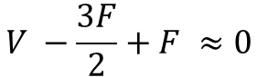
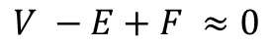
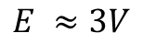
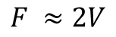
Euler Theorem Proofs
For the curious
If we call each edge as a half-edge when appearing in a face, we clearly have three times half-edges as the number of faces
Half-edge count = H = 3F
But the actual number of edges is one half of the half-edge count
E = H / 2
It follows that 2E = 3F. Plug it into the formula:
$$V −E+F ≈0$$
$$F ≈2V$$
$$V −\frac{3F}{2}+F ≈0$$
$$E ≈3V$$

Slide 60
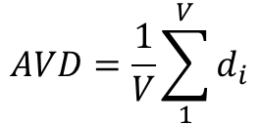
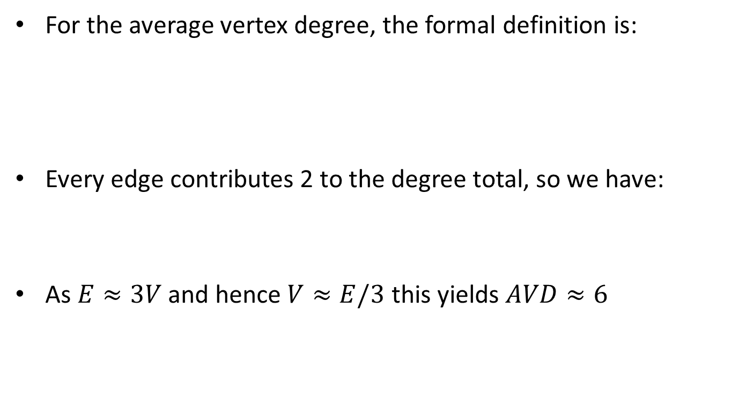
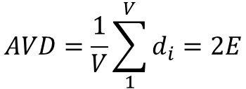
Euler Theorem Proofs
For the curious
For the average vertex degree, the formal definition is:
Every edge contributes 2 to the degree total, so we have:
As $E≈3V$ and hence $V≈E/3$ this yields $AVD≈6$
$$AVD=\frac{1}{V}\sum_{1}^{V}{d_{i}}$$
Degree of each vertex
$$AVD=\frac{1}{V}\sum_{1}^{V}{d_{i}=2E}$$

